Slide 1

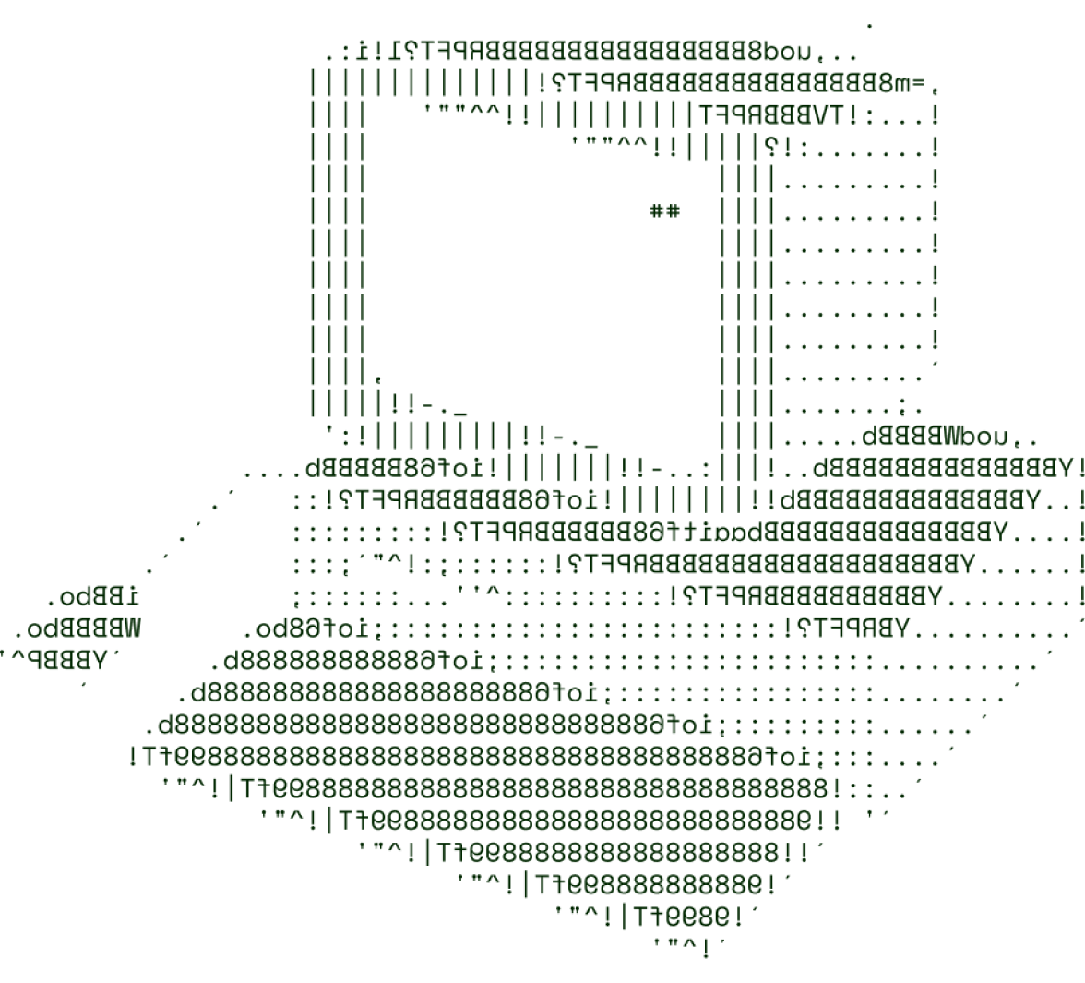

VITAL VISION
Vital Vision is an advanced chatbot designed to provide medical assistance and insights into various health conditions.
STACKUNDERFLOW

Slide 2

OUR ChatBot - WHAT IS IT?
Disease Information: Provides detailed insights into diseases, including causes, symptoms, and risk factors.
Symptom Analysis: Users can input symptoms to receive potential diagnoses and recommended conditions.
Preferred Medicines: Suggests appropriate medications based on diagnosed conditions or reported symptoms.
Doctor Consultations: Facilitates scheduling consultations with healthcare professionals, including telehealth options.

Slide 3
START
TECHNICAL ARCHITECTURE
The user interacts with the Chatbot to get information of the disease.
Tech stack:-
Frontend Technologies: HTML, CSS
Backend Technologies: Python
The AI Chatbot will ask consecutive questions from the user
Flowchart explanation:-
This is a medical support Chatbot.
The user will open the website and interact with the Bot.
The Bot will ask appropriate and necessary questions needed to determine the symptoms and disease.
Next, the Chatbot will determine the possible disease and its symptoms and the accuracy of the diagnosis to the user.
It will then inform the user about the possible medications.
The Chatbot AI will then analyse the possible disease according to the user’s choices
The Chatbot will then display the Symptoms of the possible disease and the accuracy of diagnosis
END

Slide 4
SCALABILITY AND FUTURE SCOPE
Our Chatbot will distribute the functions according to the choice of user for scalability.
This will decrease the load on the system and align the functions
We used the concept of containerization.
We plan to increase the load handling capacity according to the user responses.
Occasional feedbacks will be taken from the user to improve and find the bugs faced by the users.
We will make it more user friendly and single minded towards the topic, for better results and more accurate diagnosis.

Slide 5

TEAM DETAILS

Slide 6
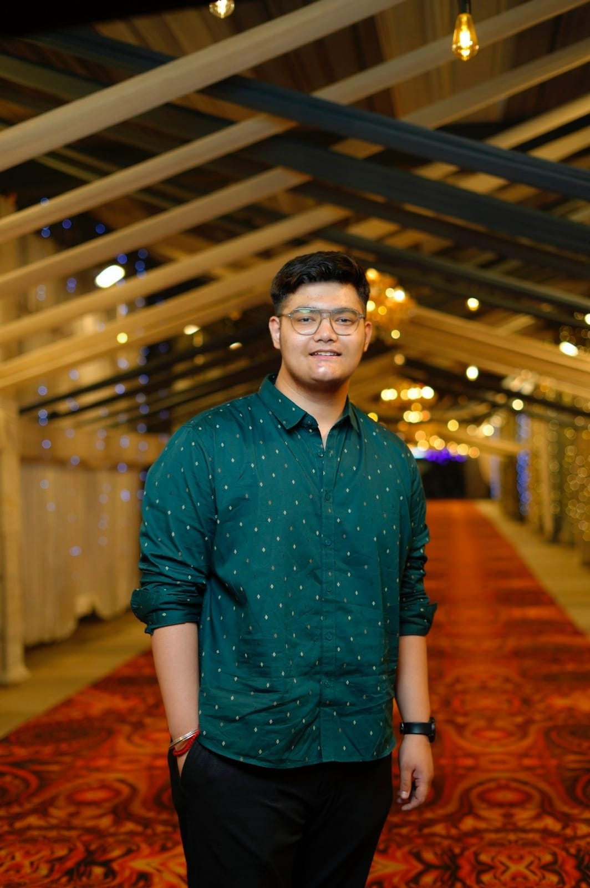


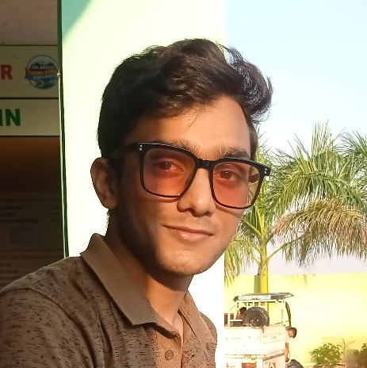

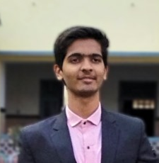
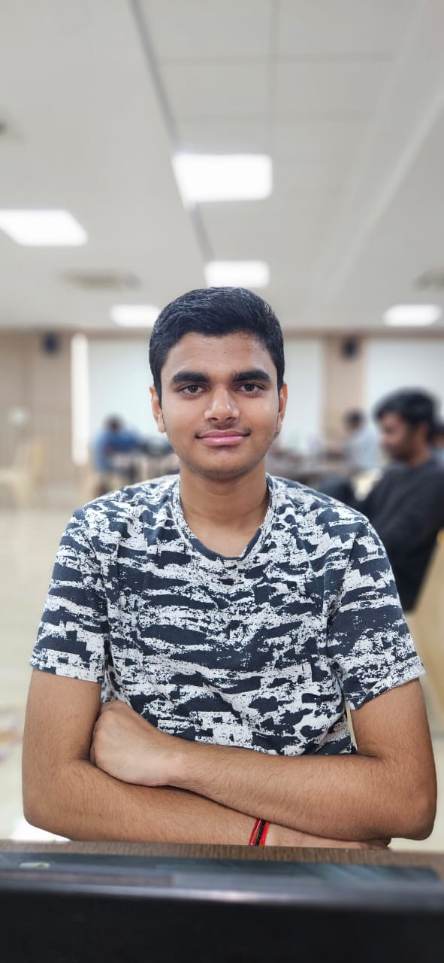
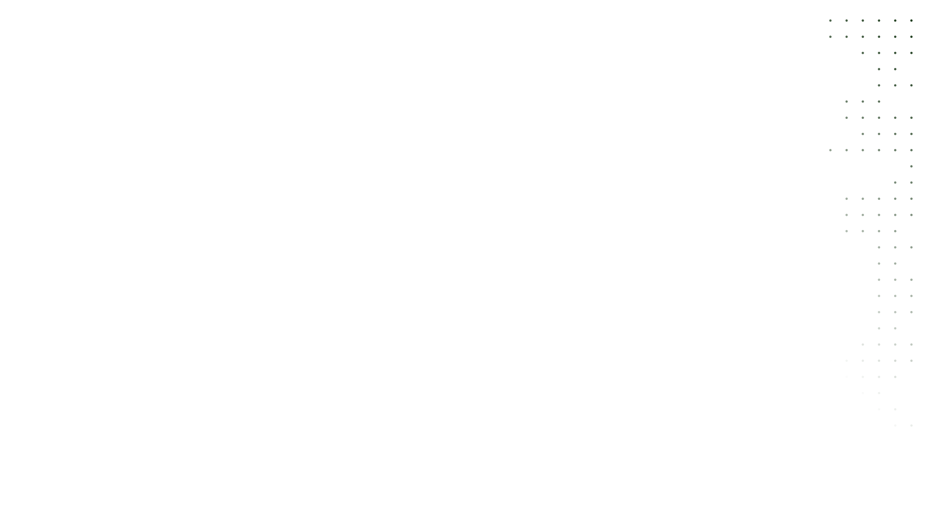
Apoorv Singh
Devash Gupta
Programmer (Team-leader)
StackUnderflow
Marketing and Designing
StackUnderflow
Naman Bothra
Ayush Pratap Singh
Programmer
StackUnderflow
Designer
StackUnderflow

Slide 7

THANKS FOR JOINING

